Slide 1
Audio authentication system for banks
Zakaria Sameh - 211867
Supervised by : Dr. Ali Hamdi

Slide 2
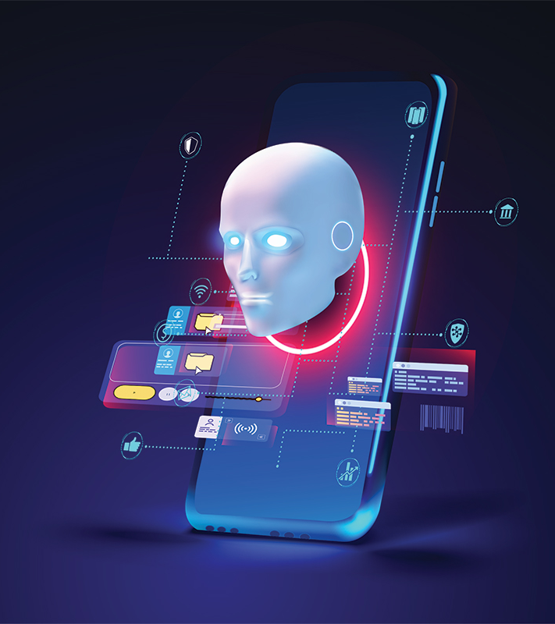
Agenda
Introduction
Background
Motivation
Problem statement
Related Works
Related works
Objective
Proposed solution
Dataset
Methodology
System Architecture
Results
Comparative Results
Demo
Conclusion
Future Work
References

Slide 3
Introduction
-What are AI-manipulated and generated audios?
-How to determine that the user is authentic?
-AI-generated Deep Fakes uses
→ audiobooks and save time on transcriptions.
→ entertainment

Slide 4
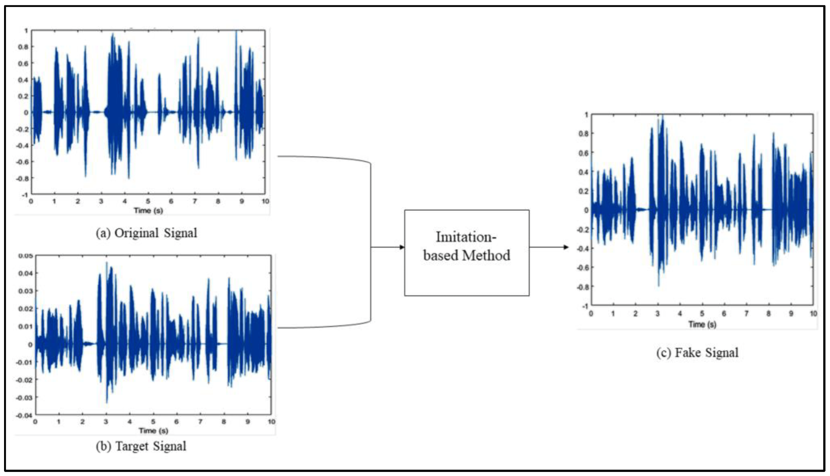
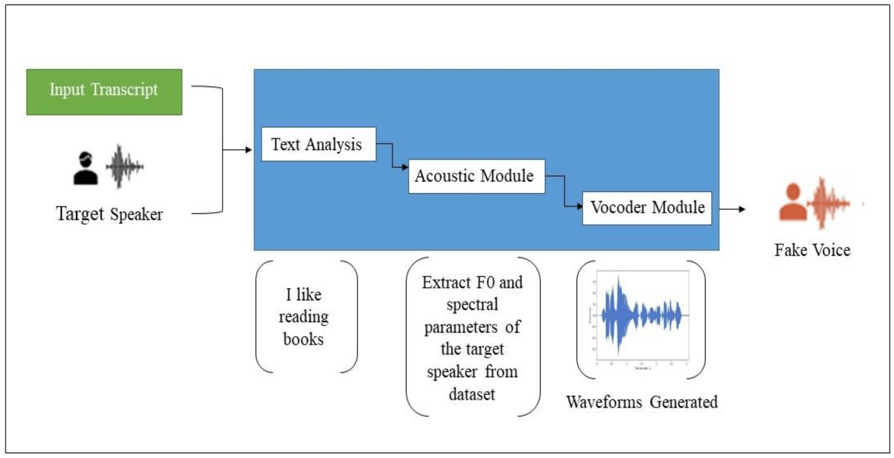
Background
Audio spoofing attacks types [5] :
voice conversion (VC) :
Synthetic-based or Text-To-Speech (TTS) :
Imitation-based
Replay-based

Slide 5
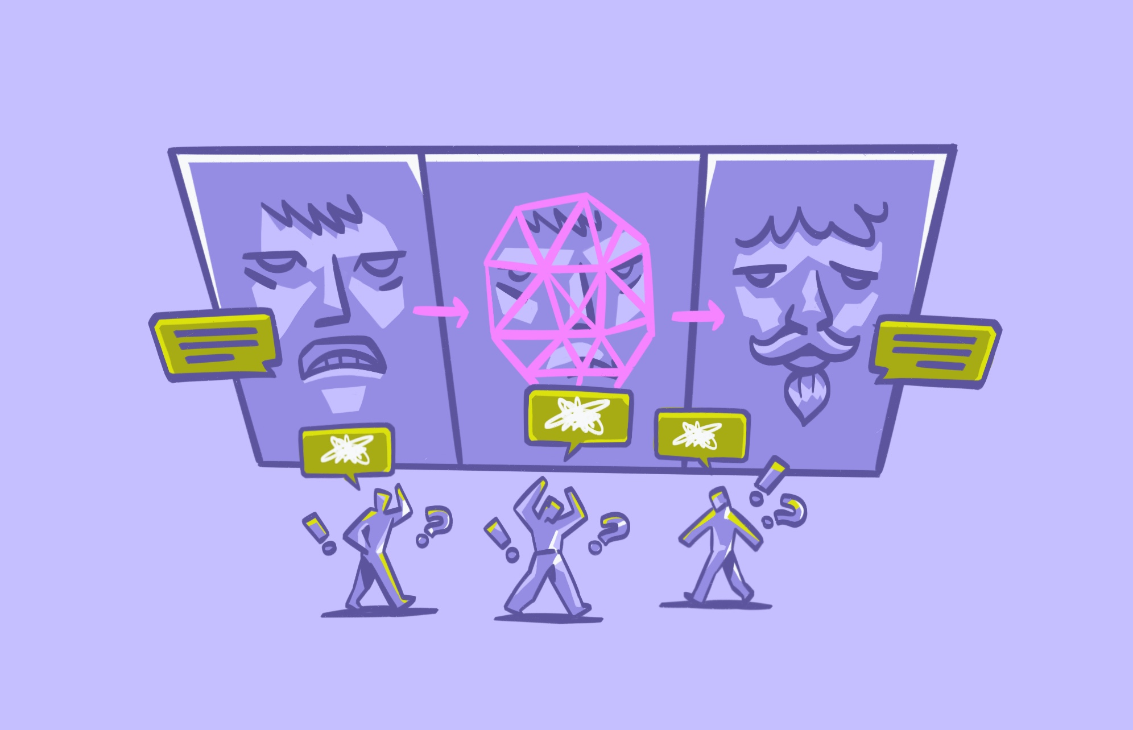
Motivation
Audio deep-fake fraud results in huge financial losses
consumers reported losing more that 4.6 billion [1]
damages banks’ reputation
damage a person's credit score
make it hard to get loans

Slide 6

Problem Statement
-Performance in regards to the lack of Accent assessment
-Excessive preprossening
-Sensitivity to noise and Balancing between all models and their trade-offs
-Advanced Generation Techniques & Generalization to New Techniques

Slide 7
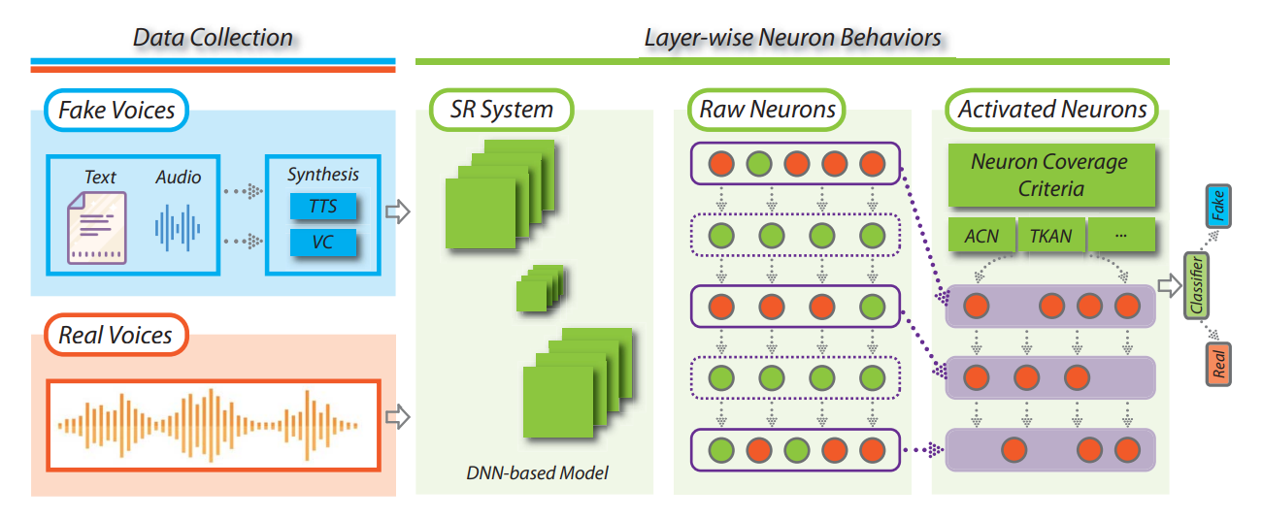
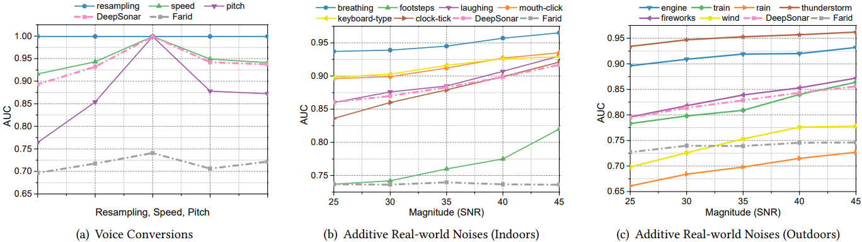
Related work 1 [3]
Recent studies in the field ADF mostly focused on performance, processing clear audios for it was mainly used for entertainment with limited real life uses, causing the field to develop strong models with solid numbers
Also leading a lot of them to neglect and be highly affected by noise
In addition to not performing well over an imitated-based datasets

Slide 8
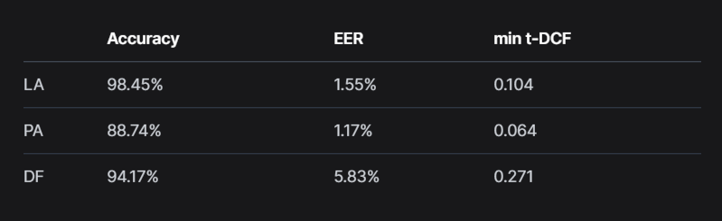
Related work 2 [5]
1. The dataset has limitations:
* Biases from recording conditions
* Simplified attacks coverage
2. Evaluation metrics:
* EER may not fully reflect system performance
* Other metrics sensitivity to specific attack types
3. System development:
* Model Complexity
* explainability remain an issues

Slide 9
Objective
Develop a system that identifies attacks in the shortest period to prevent the fraud attacks
solving encountered issues such as Accent Assessment and Excessive Preprocessing, Sensitivity to noise and performance trade-offs.
To propose an evaluation on how different Deep models performed for audio deepfake detection.
Maintain high accuracy to avoid clients’ identity conflicts.

Slide 10
Proposed solution
Compiled a diverse dataset from ASVspoof 2019 LA, DEEP-VOICE, and WaveFake datasets after analyzing them for their variety of transmission, encoding and deep fake generating methods
Utilize (MFCCs) for feature extraction alongside Mel-spectrogram
Evaluate to choose best suitable model

Slide 11
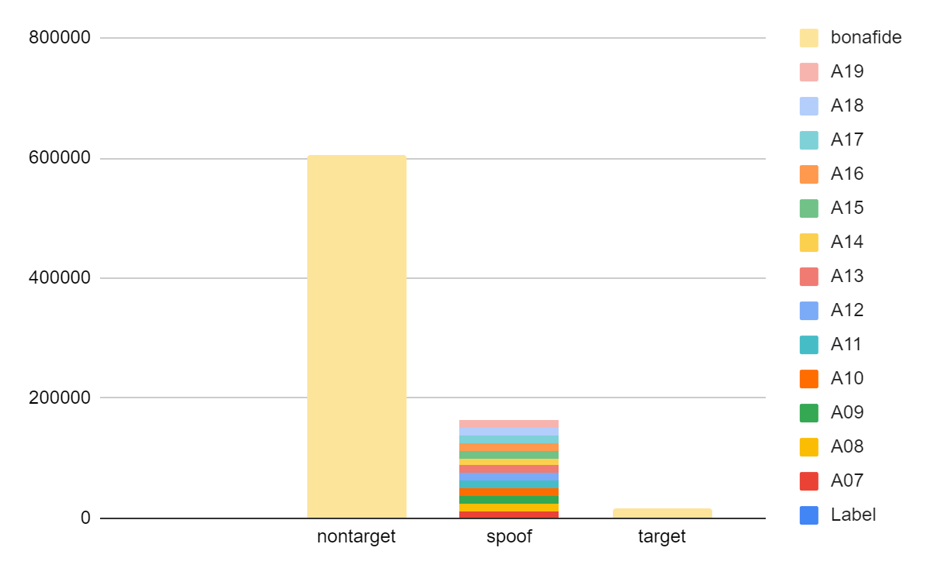
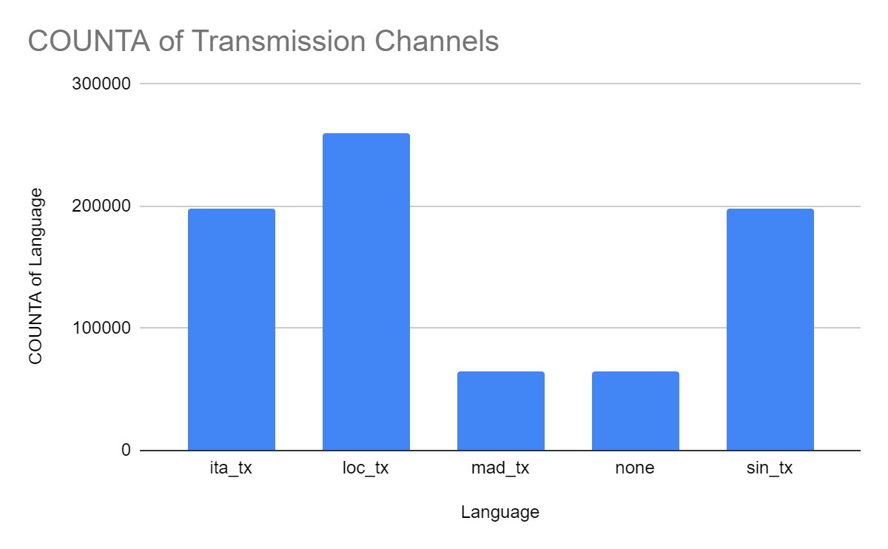
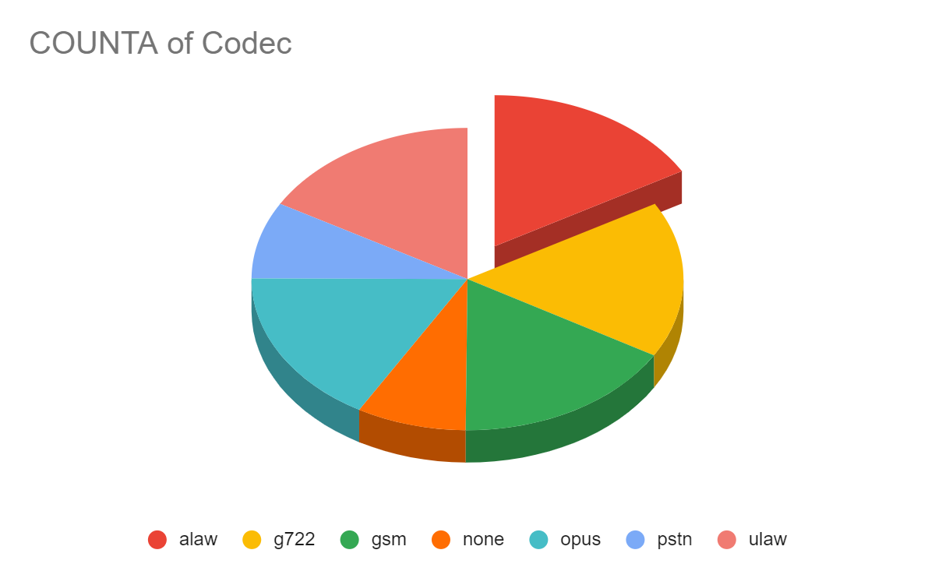
Datasets
ASVspoof 2019 LA [5]
- Focuses on TTS and VC attacksb - Standard benchmark dataset
- Includes genuine and spoofed samples
DEEP-VOICE [13]
-Targets high-quality deepfake detection -Comprehensive and realistic audio samples
Organized for thorough evaluation
WaveFake [10]
- Diverse deepfake audio generation models - Tests robustness against various deepfake techniques
- Contains genuine and synthetic samples

Slide 12

Datasets
R F
Data for m/f with british and american accent
https://www.kaggle.com/datasets/andreadiubaldo/wavefake-test
The ASVspoof 2019 Dataset to introduce language variety
http://www.asvspoof.org/index2019.html
Additional data from DEEP-VOICE dataset for high-quality samples
https://www.kaggle.com/datasets/birdy654/deep-voice-deepfake-voice-recognition

Slide 13
Methodology
Using multiple datasets to ensures that the detection system is robust against a wide range of spoofing techniques
Achieved through sampling and balancing:
ASVspoof, had 91% real against only 9% fake utterances in the data however the data had a good distribution for
transmission channels and attacking methods
Wavefake, had 10 different sophisticated generating method,
All provided 1500 from each 6 transmission and codec method in asvspoof across the 20 attack,2000 sample from each generating method, and 1000 from deep-voice for a total of 40,000 sample.

Slide 14
Methodology
-Train a number of choosed top performing models in the field of audio on refined data
-chosen models: LSTM, Resnet, M-Transformer, Wavenet, U-net, xceptionNet, VGGish,
Wave-unet, GRU,wave2vec
Test the models on ASVspoof dataset for its complexity and other attack types to choose final model
Assemble the final architecture

Slide 15
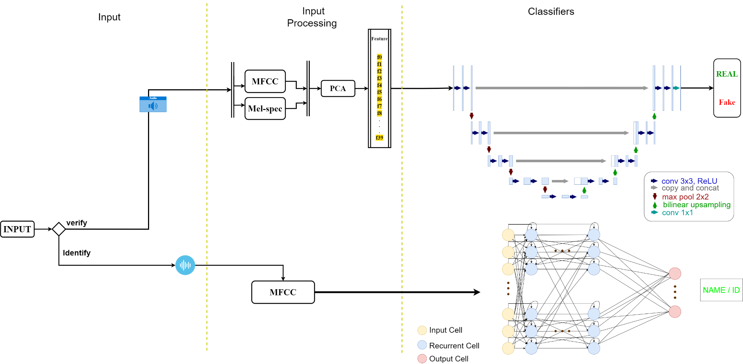

Slide 16
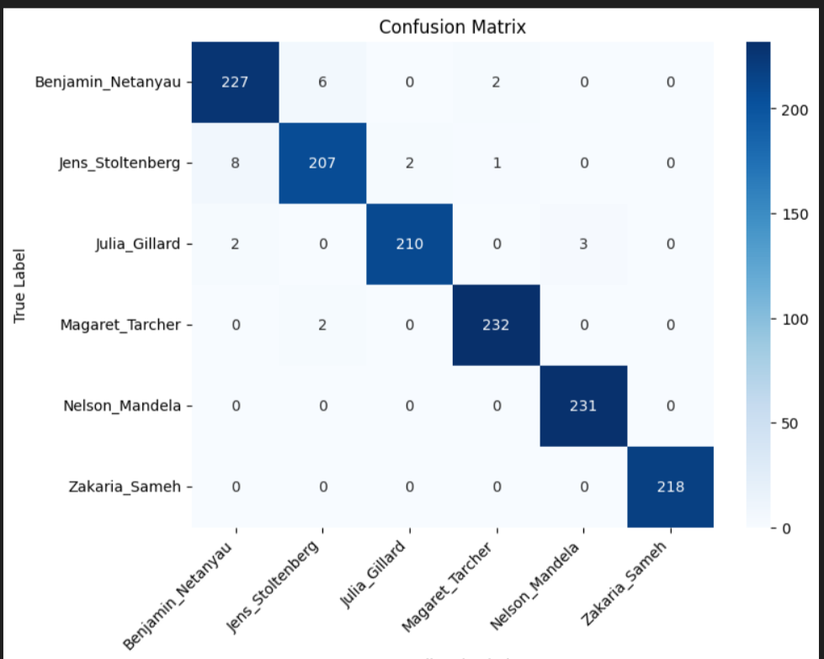
Comparative Results
Model | LSTM | Resnet | M-Transformer | wavenet | u-net | xceptionNet | VGGish | wave-unet | GRU | wave2vec
ASV | 74.68 | 91.63 | 91.38 | 86.24 | 82.34 | 82.39 | 93.81 | 67.36 | - | 92.49
refined | 92.67 | 93.64 | 92.29 | 92.99 | 93.53 | 93.71 | 96.27 | 94.63 | 80.61 | 91.29
ref/asv | 89.70 | 94.78 | 95.63 | 94.01 | 95.17 | 91.65 | 97.86 | 95.23 | 78.1 | 93.90
Chosen models:
Identification : acc 98.07
Verification:
Unet (scored : 93.53%
& 95.17%on ASVspoof)

Slide 17

DEMO

Slide 18
conclusion
Project significance : gathered and displayed reports about documented cases.
Spoofing have four major attack types
For dataset : compiled a diverse dataset
Evaluated and choose most suitable model

Slide 19
Future work
More suitable and secured method to add users instead of adaptive learning or based on it
Exploit better scaling models for identification
Introduce languages
Use or design new metrics for evaluation

Slide 20
References
https://consumer.ftc.gov/consumer-alerts/2024/02/think-you-know-what-top-scam-2023-was-take-guess
-Zaynab Almutairi ,and Hebah Elgibreen(may 2022) . A Review of Modern Audio Deepfake Detection Methods: Challenges and Future Directions.
-Run Wang, Felix Juefei-Xu, Yihao Huang, Qing Guo, Xiaofei Xie, Lei Ma, Yang Liu(Aug 2020) DeepSonar: Towards Effective and Robust Detection of AI-Synthesized Fake Voices
-TUBA ARIF, ALI JAVED (Member, IEEE), MOHAMMED ALHAMEED(Member, IEEE),FATHE JERIBI, AND ALI TAHIR (dec 2021). Voice Spoofing Countermeasure for Logical Access Attacks Detection
Yamagishi, J., Wang, X., Todisco, M., Sahidullah, M., Patino, J., Nautsch, A., Liu, X., Lee, K.A., Kinnunen, T., Evans, N. and Delgado, H., 2021, September. ASVspoof 2021: accelerating progress in spoofed and deepfake speech detection. In ASVspoof 2021 Workshop-Automatic Speaker Verification and Spoofing Coutermeasures Challenge.
-AMEER HAMZA1, ABDUL REHMAN JAVED 2,3, (Member, IEEE),FARKHUND IQBAL , (Member, IEEE), NATALIA KRYVINSKA ,AHMAD S. ALMADHOR, (Member, IEEE), ZUNERA JALIL 2,AND ROUBA BORGHOL (dec 2022), Deepfake Audio Detection via MFCC Features Using Machine Learning
-Dmitry Efanov, Pavel Aleksandrov, Nikolay Karapetyants,The BiLSTM-based synthesized speech recognition,Procedia Computer Science,Volume 213,2022,
-Liu, T.; Yan, D.; Wang, R.; Yan, N.; Chen, G. Identification of Fake Stereo Audio Using SVM and CNN. Information 2021, 12, 263.
- Trisha Mittal, Uttaran Bhattacharya, Rohan Chandra, Aniket Bera, Dinesh Manocha. Emotions Don't Lie: An Audio-Visual Deepfake Detection Method Using Affective Cues( Aug 2020)
Frank, Joel, and Lea Schönherr. "Wavefake: A data set to facilitate audio deepfake detection." arXiv preprint arXiv:2111.02813 (2021).
- D. Cozzolino, A. Pianese, M. Nießner and L. Verdoliva, "Audio-Visual Person-of-Interest DeepFake Detection," 2023 IEEE/CVF Conference on Computer Vision and Pattern Recognition Workshops (CVPRW), Vancouver, BC, Canada, 2023, pp. 943-952, doi: 10.1109/CVPRW59228.2023.00101.
-Piotr Kawa, Marcin Plata, Michał Czuba, Piotr Szymański, Piotr Syga. Improved DeepFake Detection Using Whisper Features (2023)
https://www.kaggle.com/datasets/birdy654/deep-voice-deepfake-voice-recognition

Slide 21
Thank You

